Slide 1
Soothsayer Analytics Hackathon
Samarth Marudheri
Data Scientist, Intern
Soothsayer Analytics

Slide 2


Overview
PyTorch implementation on Colab
Downsized images for faster computation (lower resolution)
Developed Pytorch Train, Validation and Test Data Loaders for the data

Slide 3
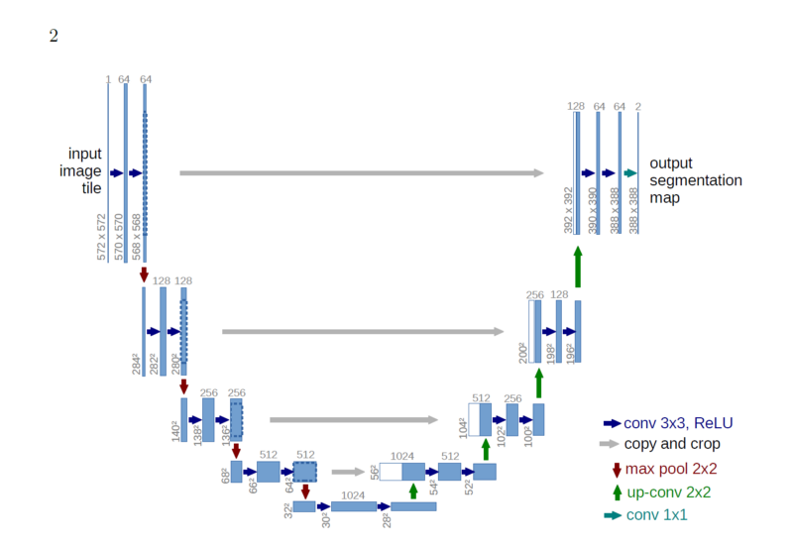
Task 1 – Object Detection (Architecture)
Built Unet inspired model
Takes about 2 hours for 2 epochs on Colab
Limited Batch Size to 15 due to memory constraints

Slide 4

Task 1 – Object Detection (Result)
Achieved 40.5% on test data (hits over iou > 0.5)
Model has a huge potential for better results given more time and computation

Slide 5

Task 2 – Classification
Built VGG-16 model in Pytorch (Transfer Learning)
Train Set: Accuracy: 91.4%, Recall: 92%
Test Set: Accuracy: 76.92%, Recall: 92.14%

Slide 6

Achievements
Implemented complete Pytorch object detection pipeline
High performance on classification task (Relative and debatable ☺)
Clean, well documented and readable code

Slide 7
Thank you!

